Slide 1
Integrated covid-19 dashboArd (TEAM-03)
PRAKHAR KATYAYAN (10826)
TANMAY SURANA (10021)
DIVYANSH MITTAL (9756)

Slide 2
DASHBOARD:
The dashboard will contain information related to the COVID-19 cases, The new cases, active cases, recoveries and the deaths all would be recorded and updated on the dashboard and the updates in respect to the COVID-19 cases will be displayed on the dashboard in the form of graphs.
We will be using Geo Charts, State Geo Charts, Pie chart and bar graph to reflect the information about the new cases and sharing of other information in respect with COVID-19. Thus, providing a live tracker for the cases of COVID-19 in India and across the globe.
The dashboard will give the us a better idea and a transparent statistics of the cases and would be reflected on the website in the form of graphs and will make it easier for the users to understand and get a better idea of the situation of COVID-19.

Slide 3
GOVERNANCE MODEL:
This project is designed to help the government to fight against COVID-19. The project comes up with the idea to divide the governance and monitoring of the citizens in respect to the COVID-19 by the governance of a city headed by the MP, latter divided into number of legislative constituency followed by the wards in the city govern by the corporators. This module follows the hierarchy as shown in the next figure where the city is leaded by the MP of the city, under whom the MLA’s of the city will be reporting and these MLA’s will be leading the local corporators of the city representing their respective wards.

Slide 4
MP
NUMBER OF MEMBER OF PARLIAMENT
MLA
NUMBER OF MEMBER OF LEGISLATIVE
CORPORATOR
NUMBER OF WARDS

Slide 5
DESCRIPTION:
This project is a web based application that allows the locals to register on the platform and to post article related to COVID-19. The users can post information regarding COVID-19 suspects in their area/locality, can spread awareness about the same, share information related to lockdown not being followed in their area, can share Symptoms of COVID-19 if they have any, any lack of emenities in their area or lack of essential supplies, can share any black-marketing happening in the area and post any information that will eventually help the government to fight against COVID-19.
The platform helps the user to share such article that will be clustered constituency wise thus each MLA will be acknowledged to each issues arising in their constituency without creating a mess. This will lead to clustering of complains, suspect, problems, not following the lockdown cases and black-marketing occuring in the city constituency wise thus, leading to better governance and handling of the issues. The MLA will guide the respective corporator of the wards to handle the cases and to resolve them, preventing the spread of COVID-19, sanatizing the area effected, isolating the suspects and to monitor the black-marketing taking place in the city.

Slide 6
The web platform will show all the article as posted by the users of the city, latter filtering them on the basis of the different category of COVID-19, awareness and information about corona virus constituency wise. The issues will be dealing in a priortiy manner, that will be classified based on the frequency of the nature of complains (Say: awareness about lockdown & COVID-19, irresponsibility of locals, not following rules of lockdown, supply of essentials, any suspect of COVID-19 or testing) coming from a respective area that will be belonging to the ward in a particular constituency.
For a better understanding of the Project, let us take the following example:
Lucknow is the city. The users on the web platform will post article that will be clustered constituency wise under the category of COVID-19 or LOCKDOWN.

Slide 7
MP
1
MLA
9
CORPORATOR
110

Slide 8
A user informs about a suspect of COVID-19 in his area/locality by creating a post on the web application mentioning his City, Constituency, locality and COVID-19 in the TAGS section of the create article page. His post will be uploaded on the site, the officials in charge of the respective constituency will inform the corporator of the ward under whose governance the area/locality comes under. The corporator will take the further steps to deal with the issue. All this will be headed by the MLA of the constituency who will be reporting to the MP of the city.
This platform will benefit the government of India to fight against COVID-19 and to know the cases and complains coming from the locals of the area. This will allow the government to filter the issues based on the city, constituency and ward and solving them on a much smaller and effective scale without creating a mess, ignorance and panic in the country.
It is a tough time for the country, We being a nation of 1.3 Billion people becomes difficult to manage and respond to the citizens, this platform will help to divide the governance model from State to City to Constituency to ward this will help the government to focus on the issues arising from respective region creating a hierarchy governance model.

Slide 9
COUNTRY
(PM)
STATE
(CM)
CITY
(MP)
CONSTITUENCY
(MLA)
WARD
(PARSHAD)

Slide 10
TECHNOLOGY USED:
Drupal 8 (Content Management Syatem)
HTML5
CSS3
Javascript
Bootstrap

Slide 11
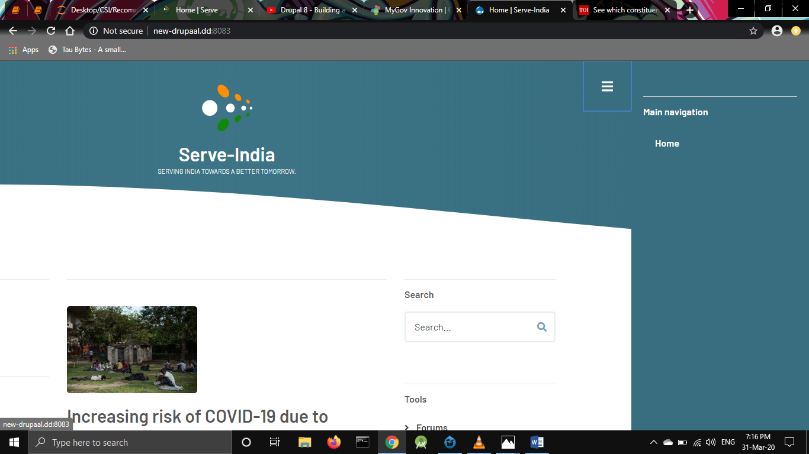

Slide 12
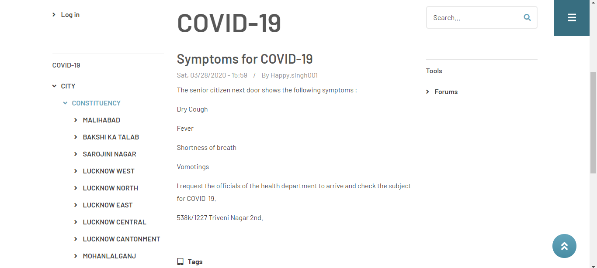

Slide 13
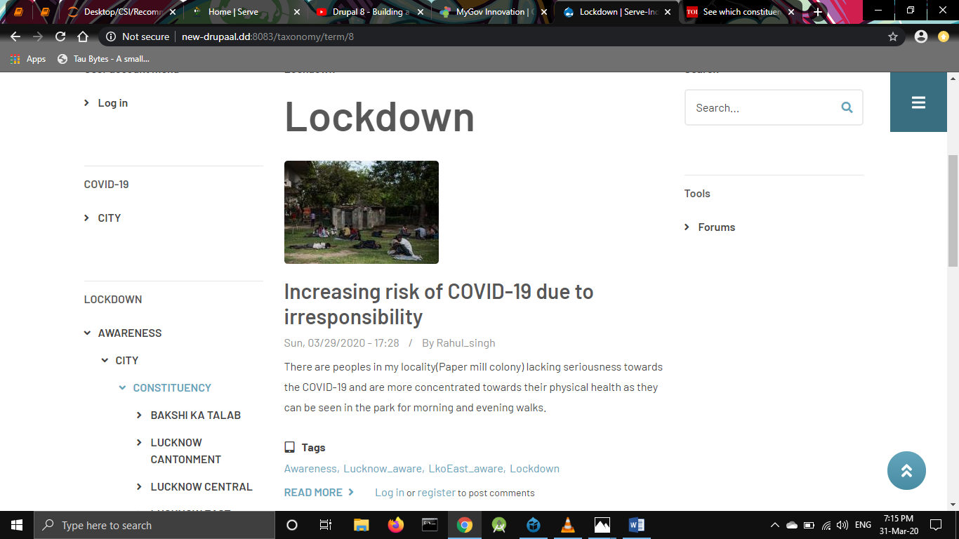

Slide 14
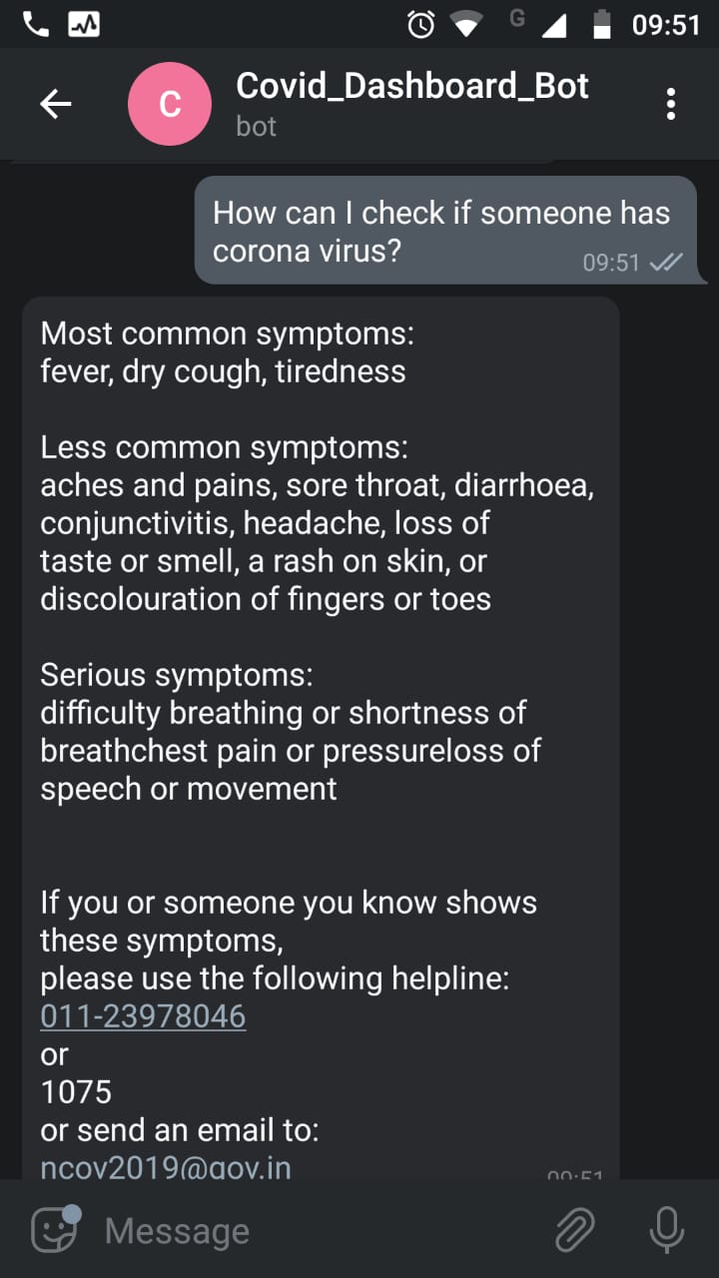
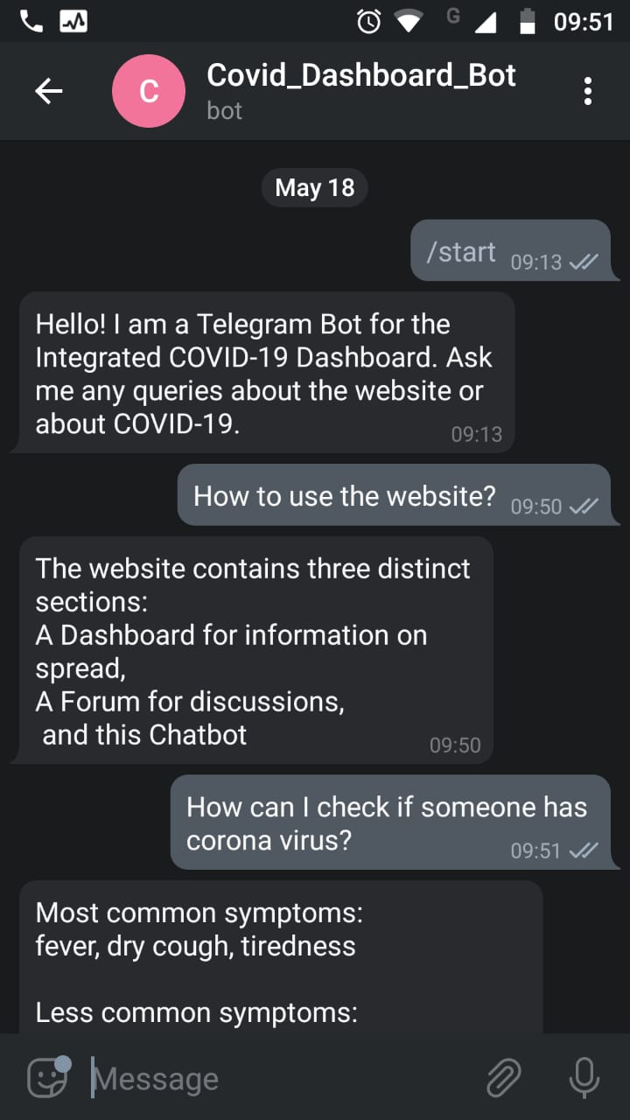
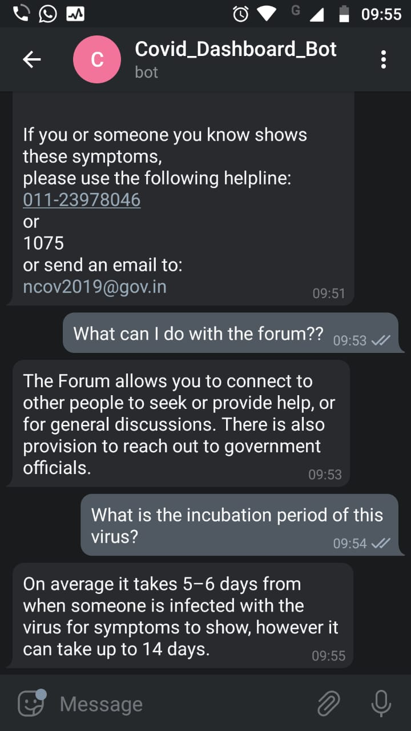

Slide 15
THANK YOU

